Slide 1
Paradigm Shift: Treating Parents Embroiled in Conflict
SHARON RYAN MONTGOMERY, PSY.D.
TAMSEN THORPE, PH.D.
MORRIS COUNTY PSYCHOLOGICAL ASSOCIATION
NOV 10, 2021

Slide 2
High Conflict Dynamics
Conceptualization/Assessment
Negative impacts on parenting & children
New research on diversity & coparenting
Personality disorders and helpful tips
Paradigm shift for therapists
Referrals & Resources
Notes:
Assess for the usual pathology ex: depression, substance abuse with high conflict parent(s) a focus on personality traits/disorder
Also considering that perhaps the issue lies more in that the relationship is a poor fit between the partners
Always looking at what are the other contributions pressing on the couple/family ex: intrusive in laws.
What are the cultural negative influences and how can the parents potentially capitalize on these contributions for healing
Re children, what is the frequency/severity of the conflict they have been exposed to and what sxs are they exhibiting
Range of exposure: from DV (not the focus of this talk) to subtle but powerful non verbal communication to parents being disconnected
Any good role models? Who are the connected to?
Paradigm shift in therapeutic approach: These folks need mindfulness to calm down focus on present/future v. past, skills/communication tech, DBT, creative probem solving skills v blame
Resources: more specialized

Slide 3
The Problem: High Conflict Parents/Families
One or both parents with a “high conflict” personality traits or disorder
High-Conflict People
Rigid and uncompromising
Emotions dominate thinking
Difficulty accepting and healing loss
Inability to reflect on own behavior
Difficulty empathizing with others
Preoccupied with blaming others
Avoid responsibility (for problem or solution)
Depends on others to solve problems
Bill Eddy, LCSW, ESQ, High Conflict Institute
https://www.highconflictinstitute.com/
Notes:
When person unable to operate with flexibility and the ability to adapt
behavior becomes rigid
this causes significant social impairment
which causes significant internal distress
this rigid behavior “evokes” responses in others which “validate” their inflexible beliefs
Blame:
People with personality disorders truly believe that forces outside themselves are responsible for all of their problems.
Not taking accountability: leads them into intense conflict & sometimes litigation against that individual or group.
Difficulty accepting responsibility: Often grudge holders/stuck. Not going to apologize
Right Brain = emotions dominate. Part of the treatment to calm = wise brain prior to attempt at prob solving

Slide 4
High Conflict Personalities - Externalizing Responsibility
“High Conflict People” externalize by focusing on a specific person or group - their “Target of Blame”
This leads them into intense conflict in relationships, the workplace and sometimes litigation against that individual or group:
“He’s the cause of all of my problems. Once he’s out of my life, everything will be fine.”
“I had to hit her, after what she said to me.”
“The children would be better off if my ex was dead.”
Notes:
Target of blame often extended family members who may or may not have played an important role in creating or maintaining problem
Historically litigation towards others: Ask about this on your intake

Slide 5
Impact of High Conflict on Parenting
Role Reversals/Parentification
Children seen as either allies or enemies - Splitting
Involve children in all disputes
See child’s needs as same as parent’s
Lack of empathy for child
Project negative qualities onto child
Parent emotionally & physically unavailable
Abuse of child (physical, sexual, neglect, emotional, verbal) as object
Threat, lack of impulsive control, dominance, etc.
Notes:
Parentifying children - burdening them with responsibilities or emotions that are not age appropriate
Parents may be checked out on the phone, busy with legal paperwork, having an affair
Abuse may be less obvious. Not listening to them, you are just a kid you have no say.

Slide 6
Impact of High Conflict on Children
Tremendous anxiety and insecurity - Trauma in severe cases
Depression/Loss Issues (75% of adult mental health issues begin in adolescence)
Behavioral problems - inconsistent/competitive parenting
Loss of sense of self - parent’s needs/anger taking precedence over child’s needs
Identification with aggressor in feelings and/or behavior
High conflict as an effect rather than cause
Loyalty conflicts
Academic decline
Notes:
Here are some of the sxs that children of high conflict families may have:
Trauma: Avoidant of school or 1 parent
Adolescents are more prone to have negative effects of divorce and most parents wait under the kids are older even though this is a vulnerable time for teens. They need rules and consistency especially.
Identification: the kids become very angry, they most likely do this in your office
They act out with parents and siblings
Loyalty: they side with 1 parent as a way out of the conflict. Often hiding out in their room/basement/electronics. May go with more permissive parent. Especially complicated when 1 parent moves = relocation
Academic decline very prevalent
Separation/Individuation problems (clingy, transition difficulties; sleep disturbances; fears; poor concentration/school difficulties)
Can have multiple losses like extended family, peers, school. Unpredictable access to one parent.
Defiant/oppositional, manipulating, attention seeking, spoiled
Due to parents needs and anger, child’s needs get overlooked. Therefore, children can be pleasers, dependent, or may rebel typically in teen years.
Acting out or splitting
Transition/separation problems, missing other parent (excessive phone contact during other parents time), visitation refusal

Slide 7
New Research on Diversity
Unmarried Parents Findings
(Fagan et al., 2020) Descriptive study of low-income, never married fathers
To stay involved with their children these fathers need to maintain at least an adequate coparenting relationship with the mother
Fathers with children by multiple partners (12-13% so fairly widespread, especially among AA and Hispanic men))
Show less optimal parenting
Tend to have more personal challenges
Increased likelihood of their children not seeing them
(Mallette et al., 2020) Unmarried, fragile families
conflictual parenting negatively impacts the mother’s mental health & quality of their parenting
coparenting support facilitates fathers involvement
consistent early father involvement is predictive of less maternal depression later in the child's life
(Kopystynska et al., 2020) Longitudinal study of low-income, never married parents where education was provided to expecting or parents of infants
Found that coparenting skills were below par when parents experience destructive conflict = hostility
Constructive conflict can be beneficial to cooperation in caregiving
Notes:
Historically research conducted with middle class, heterosexual, married parents
In our practices many of us are seeing more never married, same sex, diverse couples.
Some of the newer research focuses on different family structures
A summary finding across some of the studies is that fathers are more vulnerable to interparental discord than mothers
Fagan: 1 finding that more common among AA and Hispanic fathers is that they have more coparent relationships with relatives v. mothers so the implication is that we need to assess the term coparenting more broadly

Slide 8
New Research on Diversity
Adoption and Queer Stepfamilies
(Farr, R. H., Bruun, S. T., & Simon, K. A., 2019)
Found a child’s outcome is closely related to how parents handle family conflict regardless of parental sexual orientation
Research demonstrated significant association between supportive co-parenting and fewer child behavior problems - included same-sex families with adopted children
(Bermea et al., 2020)
Found that in stepfamilies, queer individuals faced adversity in heteronormative US legal system
Former hetero partner may threaten to sue for sole custody
Get judged at a higher level of scrutiny by court officials than heterosexual couples.
When co-parenting , these systemic adversities lead to additional stressors for Queer parents
Notes:
Implications for therapists when working with queer families who are in conflict/divorcing, in order to mitigate the special challenges, are to utilize an affirming stance about the sense of family (encourage positive and cohesive family interactions in supporting childrens adjustment) and provide access and encouragement for positive outcomes to specialized services should they need them like ex: custody professionals

Slide 9
Prevalence of Personality Disorders (NIH Study 2001-05)
Study conducted by the National Institute of Health (U.S.) included over 35,000 people representative of the US population & reported prevalence of 5 “high conflict” personality disorders:
Narcissistic = 6.2%
Borderline = 5.9%
Paranoid = 4.4%
Antisocial = 3.6%
Histrionic = 1.8%
All have substantial overlap with other personality disorders, substance abuse, depression, anxiety, bipolar disorder, suicidal thoughts and actual suicides
----Journal of Clinical Psychiatry, 7/2004, 4/2008, & 7/2008

Slide 10
Causes of Personality Disorders
Biological factors, such as genetic tendencies and temperament at birth
Early childhood factors, such as early parenting attachment disruptions, child abuse or other trauma before age 5
Social learning –
“Invalidating environments” child being ignored for positive behaviors but getting attention for mood swings and extreme emotions
Family and community tolerance of bad behavior
Role models with personality disorders
Larger Culture - learn to get attention and rewards for drama, mood swings, narcissism and violence

Slide 11
Core Issues of Personality Disorders
Lack of Self-Awareness
Of why they are the way they are
How they contribute to own problems
How to change
-- Aaron Beck (1990), Cognitive Therapy of Personality Disorders
Notes:
So they don’t gain insights from feedback.

Slide 12
Core Issues of Personality Disorders
Lack of Adaptation
Behavior becomes rigidly patterned causing significant social impairment
This leads to significant internal distress.
The rigid behavior “evokes” responses in others which “validate” inflexible beliefs
-- Efrain Bleiberg (2001), Treating Personality Disorders in Children and Adolescents
Notes:
So resist your fight or flight urges - stay calm with them.
Don’t be too negative or charmed too easily.

Slide 13
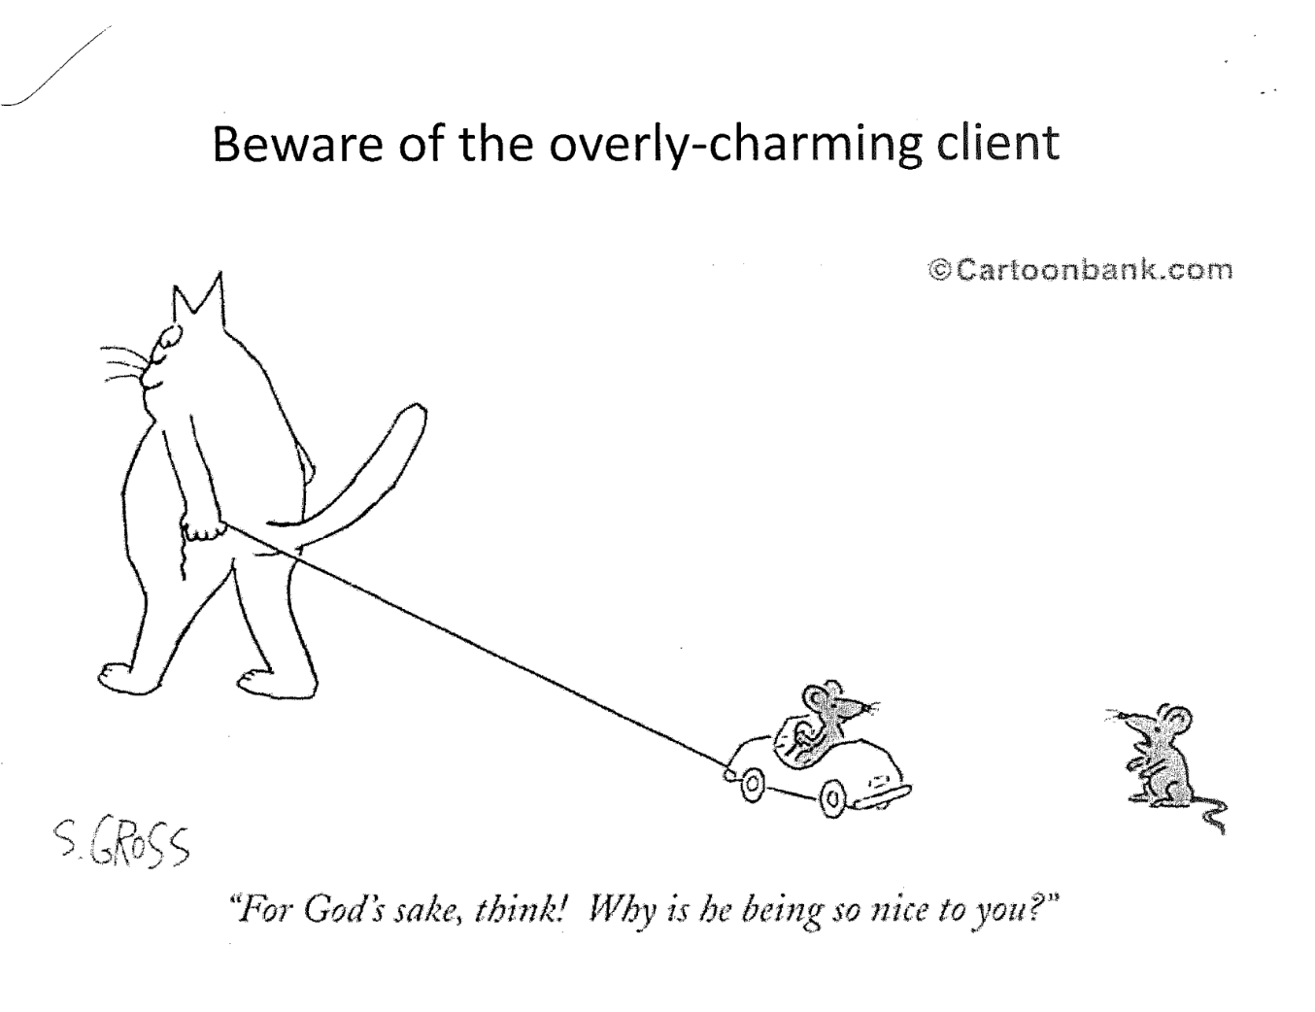

Slide 14
Borderline Personality Types
“Love you, Hate You”
Fear of abandonment - clinging & manipulation
Seeks revenge and vindication
Dramatic mood swings
Sudden and intense anger, out of proportion
Impulsive, risk-taking, self-destructive behaviors

Slide 15
Specific Tips for Borderline types
Listen with empathy
Stay calm and matter-of-fact when they get angry (and they will)
Keep an arms-length relationship: not too rejecting but not too close
Have clear boundaries - when you’re available and when you’re not
Be consistent and predictable

Slide 16
Narcissistic Types
“I’m very Superior “
Fear of being inferior or powerless
Belief in a very superior self-image
Absorbed in self, own needs, own viewpoint
Feel entitled to special treatment
Lacks empathy for others

Slide 17
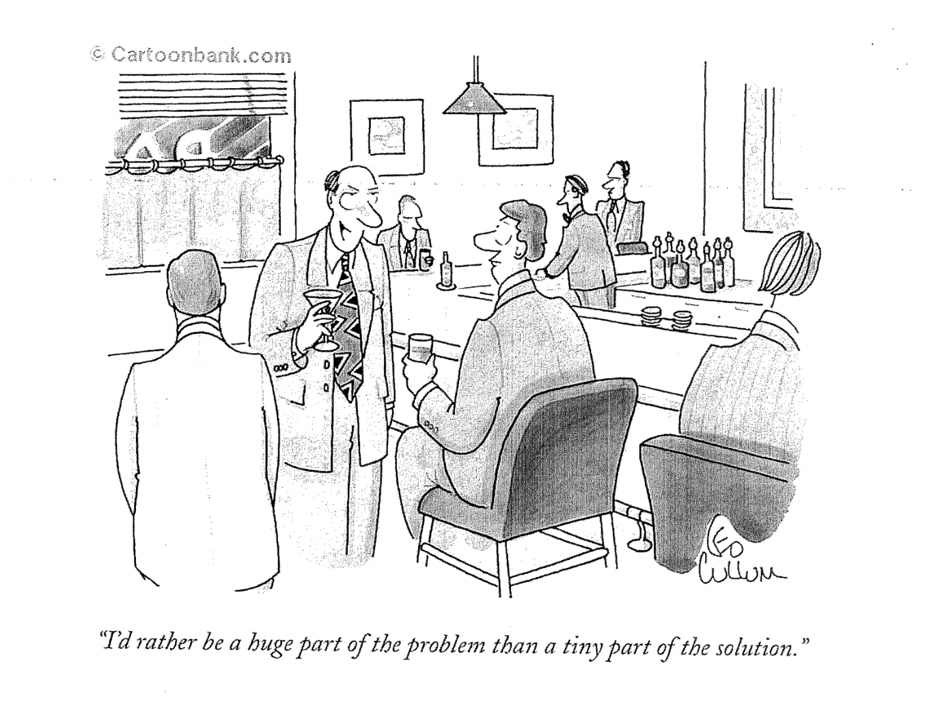

Slide 18
Specific Tips for “Narcissistic” Types
Be respectful and resist insulting them
(You may be tempted due to arrogance and insensitivity to others)
Resist any efforts seeking special treatment
Reassure them they are important, but everyone must follow rules and policies
Give praise for positive efforts/skills

Slide 19
Histrionic Types
“Always Dramatic”
Fears being ignored and left out
Drive to be center of attention
Constantly dramatic and theatrical
Exaggerates and may make up stories
Difficult focusing on tasks or making decisions
Notes:
Histrionic female often pair up with Narcissistic male types which results in lots of conflict. They both want attention!
The female may overfocus on appearance which the Narcissist likes on his arm

Slide 20
Specific Tips for Histrionic Types
Don’t get hooked by their stories
Interrupt the drama by moving on to another important task
Plan to spend more time doing ordinary work with them
Give them a sense of empowerment
Emphasize how they can help themselves
Notes:
Interrupt the drama - Calm first

Slide 21
Paranoid Types
“I’ll Never Trust You”
Fear of being exploited
Endless doubts about friends, professionals, etc.
Misinterpret ordinary events or comments as demeaning or threatening
Bear long-term grudges
Misperceive others as attacking them - “counter-attacks” first (pre-emptive strikes)
Fear and expect conspiracies against them
Notes:
MMPI II research on the divorcing population, especially those involved in heated legal issues, often shows an elevation on the PA scale. Which is understandable.
If someone with a preexisting problem with paranoia is going through this then suspiciousness is worse.

Slide 22
Specific Tips for Paranoid Types
Be as non-threatening as possible
Be reassuring, but don’t expect them to trust you
Don’t pressure them to open up about things
Respect caution and desire to only reveal what they have to
Explain that policies require you to do certain things
Feels less personal
Notes:
If is often very difficult to connect with paranoid types. They may take your actions personally ex: if you are a few mins late.

Slide 23
Paradigm Shift for Therapists
Be aware of your counter-transference
Feelings, attitude, bias
Handle it constructively
Don’t over-react or attack
Clear, calm, professional communication
Firm, consistent, but empathetic
Set up rules of communication and your relationships, telephone policy, email policy
Use feedback and mirroring/be a reality tester

Slide 24
Paradigm Shift for Therapists
Address self-destruction, self-sabotaging effect of their behavior
Promote an emotional separation and divorce as ultimate goal
Don’t encourage black or white thinking, or splitting or win/lose mentality
Don’t fuel conflict or join in to their distortion and overreactions -Reframe and neutralize
Focus on solutions, multiple perspectives and proposals

Slide 25
Paradigm Shift for Therapists
Discourage rehashing history and looking back - Future orientation
Educate regarding the reality of “sharing” two homes and importance of healthy relationships with both parents
Caution around deleterious effects of passive & aggressive expressions of anger on children
Focus on areas of agreement –
(Picture of children helps) common love, goals and that they not be scarred by divorce/conflict

Slide 26
Paradigm Shift for Therapists
Avoid dual roles by answering visitation/parenting time questions
Maintain objectivity/neutrality - Be a reality tester
Keep focus on children's advocacy/healthy coparenting has huge positive impact on children
Assume a firm, consistent but supportive and empathetic stance

Slide 27
Paradigm Shift for Therapists
Set boundaries and rules in writing
Stay within your area of expertise
Seek consultation if needed
Know the treatment options and make referrals

Slide 28
Potential Interventions/Referrals
Therapeutic Supervised Visitation
Therapeutic Reunification (if parent-child resist/refusal dynamics)
Mediation/Dispute Resolution
Therapeutic Mediation
Parent Coordination
Arbitration
Collaborative Divorce (divorce coaches and child specialists)
Family Intensives (online or in-person)
Education (ex. New Ways For Families)
Forensic Evaluations
Notes:
Courts have become more settlement oriented and more reliant on mental health professionals, with the goals of quicker response times and buddering the children better from the conflict and removing them from the court system and litigation.
Online coparenting course: Parenting without conflict, high conflict institute
Coaching sessions available as adjunct
Family intensives: building family resilience

Slide 29
Resources
COPARENTING RESOURCES
https://afccnet.org/Resource-Center/Resources-for-Families
https://conflictplaybook.com
https://familytransitions-ptw.com/new-beginnings-program
https://highconflictitistitute.com/on-demand-courses
https://online.divorce-education.com
https://uptoparents.org
MEDIA
https://amazon.ca/Welcome-Back-Pluto-Understanding-Preventing/dp/B0042QDAQ4
COPARENTING COMMUNICATION TOOLS
https://propercomm.com
https://ourfamilywizard.com
https://talkingparents.com/home
https://coparenter.com
https://civilcommunicator.com
https://www.cozi.com
https://sharekids.com
All of these resources are provided in the following book.
Ph.D., J. M. A., Esq., M. S. P., & Ph.D., S. M. (2020).
Overcoming the Alienation Crisis: 33 Coparenting Solutions. Overcoming Barriers Inc.

Slide 30
Contact Information
Sharon Ryan Montgomery, Psy. D. Tamsen Thorpe, Ph.D.
sharonrmpsy@gmail.com drthorpe@directions-cls.com
License Psychologist #1931 License Psychologist #3826

