Slide 1
CANNABIS USE AND THE ADOLESCENT BRAIN
Ashley Gorman, Ph.D., abpp
Board certified in CLINICAL neuropsychology
Morris psychological group

Slide 2
LEARNING OBJECTIVES
Review the neurocognitive effects of marijuana on the adolescent brain
Address whether the effect of adolescent exposure differs from the same exposure in adults
Discuss potential impact of legalization on usage and long-term impacts in adolescents.
Address how various populations are differentially susceptible to and affected by marijuana use.

Slide 3
Cannabis use in United States
17.9% of people 12+ reported using cannabis in the past year (2020; NIDA/NIH)
As of 2015, 23% of individuals in 8th through 12th grade reported using cannabis in past month
Lifetime use in 2016 (NIDA/NIH):
15% age 12-17
52% ages 18-25
46% age 26-65
22% ages 65 and older

Slide 4
Incidence/Prevalence of Cannabis Use
2019 US National Survey on Drug Use and Health
13.3 of adolescents age 12-17 had used MJ in past year
42% of these adolescents reported first time use
22% of high school seniors reported current cannabis use
Monitoring the Future Study (NIDA/NIHA)
Cannabis use increased over the past decade (22% to 36%)
Perceived risk among HS seniors decreased from 80% to 45%
9% of adults who try MJ become dependent; 17% of adolescents become dependent

Slide 5
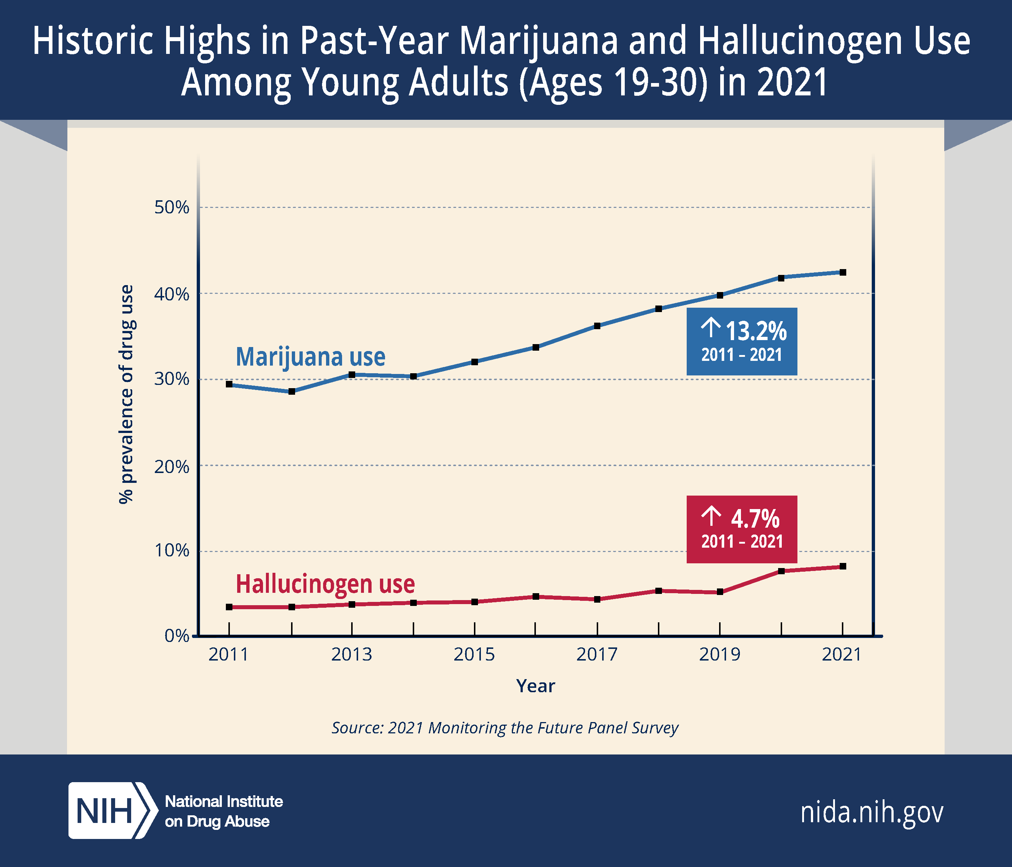

Slide 6
Racial and Ethnic Differences in Cannabis Use following Legalization
Martins et al. (2021; JAMA)
Survey data from 2008 to 2017 in states following legalization
Odds of past month use increased among Hispanic and non Hispanic White individuals (21+)
No increased in use in non-Hispanic Black individuals (21+)
No increased use in 12-20 years old across all demographic
Among people already using, no increases in use reported in any group
Usage frequency and use-related impairment did not differ between whites and African American participants (Buckner et al. 2016)
Neurocognitive effects of cannabis on the brain does not differ across race but downstream effects of chronic usage depends on socioeconomic factors

Slide 7
Neurocognitive effects of Cannabis in Adults
Cannabis binds to CB1 receptors located in CNS
Hippocampus
Pre-Frontal Cortex
Grant et al. (2003) Meta Analysis
Effect sizes of neurocognitive changes are very small
Memory was most affected , attention and processing less affected
Cognitive differences not detected after 30 days abstinence

Slide 8
Neurocognitive effects of Cannabis in Adults
Meta Analysis (Lovell, et al., 2019)
30 studies with a total of 849 adult long term (> 2 years), regular (>4 times/week) cannabis users and over 700 non users
Cannabis use associated with small, significant effects in executive functioning, learning and memory, global cognition, and decision making
Non-significant group differences in information processing, working memory, and attention

Slide 9
Is Cannabis “safe” for adults?
No evidence of substantial, systemic effect of long-term, regular cannabis use in adults
Link to Dementia?
Public Safety Concerns: Motor Vehicle Accidents
Is the same true for adolescents?

Slide 10
Adolescent Brain Development
Neurodevelopmental period of synaptic overproduction, synaptic pruning, and increased myelination
Grey matter peaks between ages 12 and 14
Grey matter decreases and white matter increases
Less frequently used neurons are pruned in preteen years to build complex networks for decision making skills of adulthood

Slide 11
Adolescent Brain Development
Locations of synaptic pruning are involved in social, cognitive, and emotional regulation
CB1 receptors involved in synaptic pruning
Pruning and maturation continues into emerging adulthood
New brain data suggests that the human brain does not reach full “adulthood” until age 25 (up to age 30 (Kwan et al., 2020)
Legal definition of adulthood does not match with neural development

Slide 12
Cannabis effects on Adolescent Brain Development
CB1 receptors are involved in synaptic pruning and increase during adolescence to play a role in genetic expression of neural development.
Alteration of the cannabinoid system during adolescence can lead to a cascade of functional and structural brain changes
Exposure to cannabis during this critical phase of synaptic pruning of adolescence can delay or impede maturation of the prefrontal cortex (involved in decision making and executive functioning)

Slide 13
Structural Brain Changes in Adolescent Cannabis Use
Grey Matter Findings: Mixed Results
Some studies show no group differences
Other studies show decreased right medial orbital prefrontal cortex volume and hippocampal compared to non users
Volume loss correlated with age of initiation of use
Heavy adolescent cannabis users abstinent for 30 days show smaller bilateral hippocampal volumes (Ashtari et al. 2011)

Slide 14
Structural Brain Changes in Adolescent Cannabis Use
White Matter Findings
Poorer white matter integrity in cannabis use and correlated with poor neurocognitive performance
White matter alterations (frontal-parietal) present in adolescence after a period of abstinence (Jacobus and Tapert, 2014)
White matter changes correlated with severity of use and age of initiation of use

Slide 15
Structural Brain Changes in Adolescent Cannabis Use
TAKE HOME MESSAGE
Studies suggest that when cannabis use occurs before completion of brain maturation, changes in brain structure and function may persist into adulthood, even after a period of abstinence

Slide 16
COGNITIVE EFFECTS OF CANNABIS USE
Is cannabis use correlated with mood changes or cognitive impairments?
Is there a causal link?
Does abstinence from cannabis reduce or eliminate impairments in cognition or mood?
How much abstinence?

Slide 17
COGNITIVE EFFECTS OF CANNABIS USE
Adolescents who use cannabis are more likely than adults to develop dependence, show cognitive impairment, use other illicit drugs, develop schizophrenia, and affective disorders and have suicidal thoughts (Hall et al., 2019)
Adolescents who use cannabis are more likely to drop out of school
Adolescents who use cannabis show impairments in memory, attention, processing speed, executive functioning, and motivation

Slide 18
COGNITIVE EFFECTS OF CANNABIS USE
The Dunedin Study (Meier et al., 2012)
A study of health and human behavior started in 1972 in New Zealand
Longitudinal study evaluated 1,037 individuals from birth to age 38
Neuropsych testing at age 13 and 38
Persistent users (“cannabis dependence”) showed decline in IQ of 6 points, even when controlling for education
Persistent users showed impairments in executive functioning and processing speed
Decline in IQ present for both individuals who used frequently and infrequently over the past year
Those who started using weekly before age 18 showed greater declines than adult onset users
Adult onset users did not show a decline in IQ

Slide 19
PSYCHIATRIC EFFECTS OF CANNABIS USE
Cannabis use beginning at age 15 led to fourfold increased risk of schizophrenia by age 26
Use beginning closer to age 18 carried a small, non significant risk (Meier et al., 2012)
Cannabis use associated with a 3-4 increased risk of psychosis and lowers the age of onset by six years
Strong association between cannabis use and anxiety and mood disorders, confirmed by meta-analysis of 12 prospective studies with 12,000 adults and adolescents (Mammen et al., 2018)

Slide 20
IS THERE A CAUSAL LINK?
ANIMAL STUDIES
No consistent findings on effects of cannabis on mood and behavior when not intoxicated
Low dose “weekend” use of cannabis in adolescent rats resulted in increased self-administration of heroin in adulthood (Conclusion: cannabis exposure changed biology of reward center resulting in drug taking in adulthood)
Exposure to cannabis in adolescence disrupted memory performance in adulthood and effects are dose dependent
Exposure to cannabis during early adolescence (age 16 for humans) disrupted GABA and pre-frontal circuits in adult brain; This finding not present when exposed during later adolescence
Take Home: The earlier you use cannabis, the more use it, and the more potent form you use, the greater the impact on cognition, and risk for other drugs

Slide 21
IS THERE A CAUSAL LINK?
TWIN STUDIES
Longitudinal twin study (Meier et al., 2017)
1,989 twins from the Environment Risk Longitudinal Twin Study; born in England and Wales between 1994 and 1995
IQ assessed at age 5, 12, and 18
EF assessed at age 18
Frequency of cannabis use obtained at age 18

Slide 22
IS THERE A CAUSAL LINK?
TWIN STUDIES (Meier et al., 2017 study continued)
Adolescents who used cannabis had lower IQ in childhood and at age 18 BUT those with cannabis dependence performed similarly on IQ tests compared with their twin without cannabis dependence at each age
So, non-cannabis using twins also showed a decline in IQ
Results contradict previous findings suggesting causal link between cannabis and IQ decline
Weekly use not associated with IQ decline when compared to non-users

Slide 23
IS THERE A CAUSAL LINK?
TWIN STUDIES (Meier et al., 2017 study continued)
Adolescents who used cannabis had worse EF functions at age 18 compared with non-users
When users compared with twins who used less frequently, minimal differences were detected with one exception: Spatial Span performance
BOTTOM LINE:
Contrary to previous findings in the high-profile Dunedin Study data, results from twin comparisons does not support that cannabis use caused IQ declines and instead opined that familial and environmental factors caused decline in IQ;

Slide 24
IS THERE A CAUSAL LINK?
BOTTOM LINE:
Results do not support causation between cannabis use and IQ decline
The “other” variable: familial and environmental factors caused decline in IQ
Short term use did not result in IQ decline or EF impairments BUT this study did look at memory

Slide 25
IS THERE A CAUSAL LINK?
TWIN STUDIES (Ellingson et al., 2020)
Prospective siblings study of adolescents with moderate cannabis use recruited at age 17 and followed again at age 24
1192 adolescents from 596 families in metropolitan communities
users endorsed usage levels of 7-9 days/month (about 2 days/week) by age 17
mean age of initiating use was 13.6

Slide 26
IS THERE A CAUSAL LINK?
BOTTOM LINE:
Verbal memory deficits not present at age 17 but present at age 24
Greater frequency and earlier onset of regular cannabis use did result in verbal memory impairment after accounting for environmental and genetic factors

Slide 27
IS THERE A CAUSAL LINK?
Twin Studies (Schaefer et al., 2020)
3 longitudinal twin studies collecting data from age 11 to age 29 (n=3,762)
Cannabis use in adolescence associated with greater rates of anxiety, depression, antisocial personality, other drug use, lower educational attainment, occupational status, and annual income
Cognitive data was limited to a lower score on Vocabulary subtest (but this study only included subtests from WAIS-R/WAIS-III; memory not assessed)
Comparisons between MZ twins offered limited support of a causal link between cannabis use and negative outcomes
BOTTOM LINE: Cannabis use in adolescence may impair academic functioning during high school, with downstream effects on socioeconomic status

Slide 28
IS THERE A CAUSAL LINK BETWEEN CANNABIS USE IN ADOLESCENCE AND NEGATIVE OUTCOMES IN ADULTHOOD?
IT DEPENDS
Limited support for causal link between cannabis use during adolescence and lower IQ
Strong support for a causal link between moderate to heavy cannabis use (7-9 days/month) during adolescence and memory impairment
Socioeconomic and familial factors likely moderate the relationship between cannabis and negative outcomes in adulthood
Cannabis use in adolescence may impair academic functioning during high school, leading to poorer outcome in adulthood

Slide 29
Does abstinence from cannabis reduce cognitive impairments?
YES. Abstinence for a period of 1-3 months appears to result in significant improvement in learning and memory (Schuster et al., 2018; Jacobus & Tapurt, 2014)
BUT—verbal memory in cannabis users still significantly lower than non-user controls

Slide 30
LOOKING AHEAD
National Institute on Drug Abuse (NIDA) Adolescent Brain Cognition Development (ABCD) recruited a sample of 12,0000 children age 9-10, across a diverse population, including twins, for a 10 year longitudinal study; recruitment completed in 2018
The largest long-term US study of brain development and child health
Data collected on genetics, brain imaging, cognitive testing, and daily habits from childhood through adulthood across a range of racial and socioeconomic backgrounds

Slide 31
LOOKING AHEAD: EFFECTS OF POTENCY
Studies clearly show a dose-response relationship between cannabis use and negative outcomes
The more you smoke and the stronger the potency, the worse the outcome
Average street marijuana when most these studies collected data was 6.1 to 8.8% THC
Street marijuana now contains 10-15% THC
Marijuana extracts, used in dabbing and edibles, can contain an average of 50% and up to 90% THC
High potency hash oils and waxes are up to 80-95%
What does this mean for the negative effects of cannabis use in today’s youth?
American Journal of Medicine (deShazo et al., 2018) discourages regular use of cannabis for those under age 21

Slide 32
WHAT CAN WE DO?
FIRST, FIND OUT IF YOUR PATIENTS ARE USING DRUGS/ALCOHOL
Screening Brief Intervention and referral to treatment (SBIRT) adaptation for adolescence (endorsed by American Academy of Pediatrics, NIDA, AMA)
Consider brief intervention based on Motivational Interviewing
Educate patient and family about risks of cannabis use during adolescence
Consider ethical and confidentiality when treating adolescents with substance use or abuse
https://www.niaaa.nih.gov/alcohols-effects-health/professional-education-materials/alcohol-screening-and-brief-intervention-youth-practitioners-guide
https://crafft.org/wp-content/uploads/2021/07/CRAFFT_2.1N-HONC_Clinician_2021-07-03.pdf

Slide 33
REFERENCES
Broyd, S. J., van Hell, H. H., Beale, C., Yücel, M., & Solowij, N. (2016). Acute and chronic effects of cannabinoids on human cognition—a systematic review. Biological Psychiatry, 79(7), 557–567. https://doi.org/10.1016/j.biopsych.2015.12.002
Chiu, V., Leung, J., Hall, W., Stjepanović, D., & Degenhardt, L. (2021). Public health impacts to date of the legalisation of medical and recreational cannabis use in the USA. Neuropharmacology, 193, 108610. https://doi.org/10.1016/j.neuropharm.2021.108610
deShazo, R. D., Parker, S. B., Williams, D., Ingram, J. B., Elsohly, M., Rodenmeyer, K., & McCullouch, K. (2019). Marijuana's effects on brain structure and function: What do we know and what should we do? A brief review and commentary. The American Journal of Medicine, 132(3), 281–285. https://doi.org/10.1016/j.amjmed.2018.09.006
D’Amico, E. J., Rodriguez, A., Tucker, J. S., Dunbar, M. S., Pedersen, E. R., & Seelam, R. (2022). Disparities in functioning from alcohol and cannabis use among a racially/ethnically diverse sample of emerging adults. Drug and Alcohol Dependence, 234, 109426. https://doi.org/10.1016/j.drugalcdep.2022.109426
Ellingson, J. M., Ross, J. M., Winiger, E., Stallings, M. C., Corley, R. P., Friedman, N. P., Hewitt, J. K., Tapert, S. F., Brown, S. A., Wall, T. L., & Hopfer, C. J. (2020). Familial factors may not explain the effect of moderate‐to‐heavy cannabis use on cognitive functioning in adolescents: A sibling‐comparison study. Addiction, 116(4), 833–844. https://doi.org/10.1111/add.15207

Slide 34
REFERENCES
GRANT, I. G. O. R., GONZALEZ, R. A. U. L., CAREY, C. A. T. H. E. R. I. N. E. L., NATARAJAN, L. O. K. I., & WOLFSON, T. A. N. Y. A. (2003). Non-acute (residual) neurocognitive effects of cannabis use: a meta-analytic study. Journal of the International Neuropsychological Society, 9(5), 679–689. https://doi.org/10.1017/s1355617703950016
Hall, W., Stjepanović, D., Caulkins, J., Lynskey, M., Leung, J., Campbell, G., & Degenhardt, L. (2019). Public health implications of legalising the production and sale of cannabis for medicinal and recreational use. The Lancet, 394(10208), 1580–1590. https://doi.org/10.1016/s0140-6736(19)31789-1
Hernandez, C. M., Orsini, C. A., Blaes, S. L., Bizon, J. L., Febo, M., Bruijnzeel, A. W., & Setlow, B. (2020). Effects of repeated adolescent exposure to cannabis smoke on cognitive outcomes in adulthood. Journal of Psychopharmacology, 35(7), 848–863. https://doi.org/10.1177/0269881120965931

Slide 35
REFERENCES
Kwan, L. Y., Eaton, D. L., Andersen, S. L., Dow-Edwards, D., Levin, E. D., Talpos, J., Vorhees, C. V., & Li, A. A. (2020). This is your teen brain on drugs: In search of biological factors unique to dependence toxicity in adolescence. Neurotoxicology and Teratology, 81, 106916. https://doi.org/10.1016/j.ntt.2020.106916
Lee, M. H., Kim-Godwin, Y. S., & Hur, H. (2021). Race/ethnicity differences in risk and protective factors for marijuana use among U.S. adolescents. BMC Public Health, 21(1). https://doi.org/10.1186/s12889-021-11159-z
Meier, M. H., Caspi, A., Danese, A., Fisher, H. L., Houts, R., Arseneault, L., & Moffitt, T. E. (2017). Associations between adolescent cannabis use and neuropsychological decline: A longitudinal co-twin control study. Addiction, 113(2), 257–265. https://doi.org/10.1111/add.13946
Meruelo, A. D., Castro, N., Cota, C. I., & Tapert, S. F. (2017). Cannabis and alcohol use, and the developing brain. Behavioural Brain Research, 325, 44–50. https://doi.org/10.1016/j.bbr.2017.02.025
Mizrahi, R., Watts, J. J., & Tseng, K. Y. (2017). Mechanisms contributing to cognitive deficits in cannabis users. Neuropharmacology, 124, 84– 88. https://doi.org/10.1016/j.neuropharm.2017.04.018
Schaefer, J. D., Hamdi, N. R., Malone, S. M., Vrieze, S., Wilson, S., McGue, M., & Iacono, W. G. (2021). Associations between adolescent cannabis use and young-adult functioning in three longitudinal twin studies. Proceedings of the National Academy of Sciences, 118(14). https://doi.org/10.1073/pnas.2013180118

Slide 36
REFERENCES
Schuster, R. M., Gilman, J., Schoenfeld, D., Evenden, J., Hareli, M., Ulysse, C., Nip, E., Hanly, A., Zhang, H., & Evins, A. E. (2018). One month of cannabis abstinence in adolescents and young adults is associated with improved memory. The Journal of Clinical Psychiatry, 79(6). https://doi.org/10.4088/jcp.17m11977
Shen, H. (2020). Cannabis and the adolescent brain. Proceedings of the National Academy of Sciences, 117(1), 7–11. https://doi.org/10.1073/pnas.1920325116
Tapert, S. (2014). https://doi.org/10.1016/j.ntt.2020.106916. Current Pharmaceutical Design, 20(13), 2186–2193. https://doi.org/10.2174/13816128113199990426

